Slide 1
Redesign of Registration Interfaces
Group members :
Khalil alsulaimani
Nawaf Noor aldeen
Mosab albishi
Yazeed alsayed

Slide 2
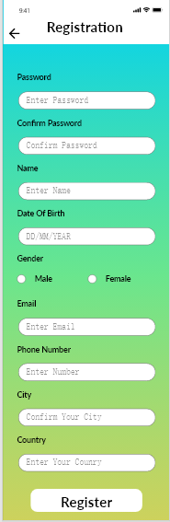
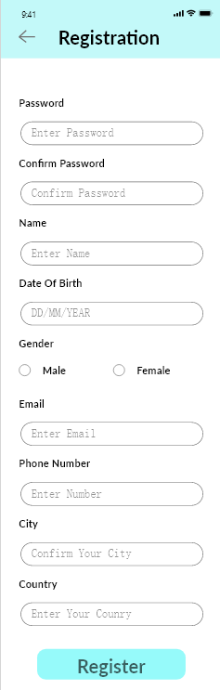
Color Design Choices
Old versions problems ?
Background color too noisy
Noisy colors reduce readability
Scanning speed
Looks unprofessional
How does the new version fix those problems ?
Better color pallet using monochromatic scheme on the top bar and buttons
Less noise by using a white background which improves readability
Looks professional and clean

Slide 3
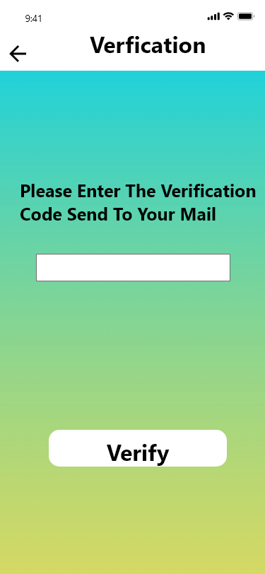
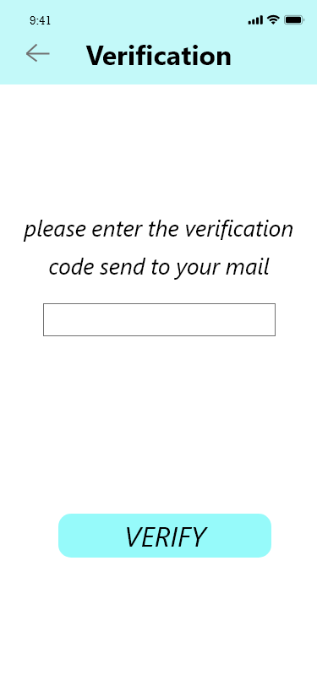
Previous version font problems:
*font too bold and dark and the bright noisy background color reduces readability and usability.
*Texts were not properly aligned.
*feels more robotic which makes it difficult
to read, so it reduces accessibility.
New version:
*new font is much more readable and usable giving the mixture of simple background color and a simple typeface.
*the simplicity and good alignment of the typeface makes it more accessible and enjoyable also professional and clean.
Font Design Choices

Slide 4




Buttons Design Choices:
For out design we have 4 kinds of buttons that we used for different actions.
First Button type is the raised button , which is used for the primary action in each interface, for example in the verification page :
The second type is the Ghost Button, used for the secondary actions and we used it for the back button in each interface:
The third type is the text button, used for less important actions and to not distract users from the interface:
And lastly we used the toggle button, where the user can chose one of multiple options and only one can be chosen, we used it for the gender choice in the registration interface:

